Slide 1

6th Grade Math
Unit 4, Lesson 4 Plotting, Ordering, and Comparing Rational Numbers – Part 1 Volume 1, pg. 152

Slide 2


Benchmark
MA.6.NSO.1.1
Extend previous understanding of numbers to define rational numbers. Plot, order, and compare rational numbers.
volume 1, pg. 152

Slide 3
Integrated Mathematical Thinking and Reasoning Standards
MA.K12.MTR.4.1 Engage in discussions that reflect on the mathematical thinking of self and others.
MA.K12.MTR.6.1 Assess the reasonableness of solutions.
volume 1, pg. 152

Slide 4

Learning Target
I can plot, compare, and order fractional representations of rational numbers.
volume 1, pg. 152

Slide 5

Warm-Up
volume 1, pg. 153

Slide 6
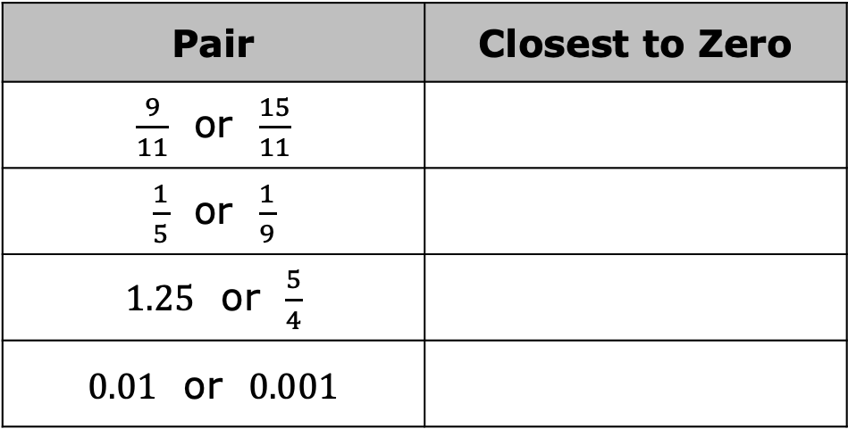

4.4.1 Warm-Up: Closer to Zero
For each pair of numbers, determine which value is closest to $0$. Discuss with your partner the strategy you used.
Pair | Closest to Zero
$\frac{9}{11}$ or $\frac{15}{11}$
$\frac{1}{5}$ or $\frac{1}{9}$
$1.25$ or $\frac{5}{4}$
$0.01$ or $0.001$
volume 1, pg. 153

Slide 7

Exploration
volume 1, pg. 153

Slide 8

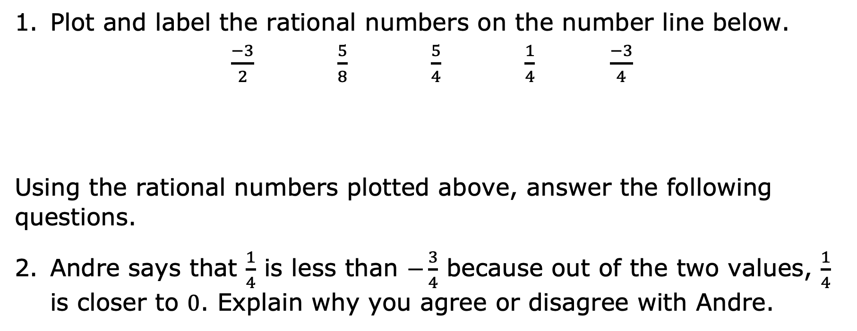
4.4.2 Exploration: Plotting and Comparing Fractions
Plot and label the rational numbers on the number line below.
$\frac{−3}{2}$ $\frac{5}{8}$ $\frac{5}{4}$ $\frac{1}{4}$ $\frac{−3}{4}$
Using the rational numbers plotted above, answer the following questions.
Andre says that $\frac{1}{4}$ is less than $−\frac{3}{4}$ because out of the two values, $\frac{1}{4}$ is closer to $0$. Explain why you agree or disagree with Andre.
volume 1, pg. 153

Slide 9
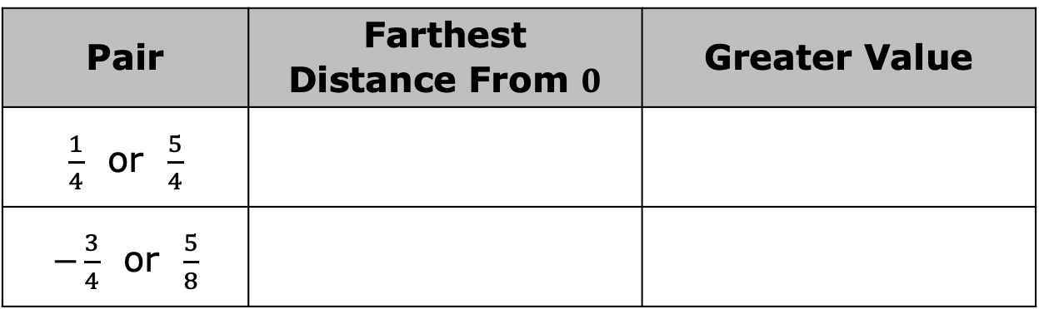

Complete the table for each pair of numbers.
Is the value that is farther from $0$ always the greater value? Explain your reasoning.
Pair | Farthest Distance From $0$ | Greater Value
$\frac{1}{4}$ or $\frac{5}{4}$
$−\frac{3}{4}$ or $\frac{5}{8}$
volume 1, pg. 154

Slide 10

Activity
volume 1, pg. 154

Slide 11

4.4.3 Activity: Ordering Rational Number Cards
Your teacher will give you a set of number cards. Order them from least to greatest.
Your teacher will give you a second set of number cards. Add these values to the correct places in the first ordered set.
In the first round of ordering, how did ordering negative numbers compare to ordering positive numbers?
What strategies helped you determine how to order the rational numbers represented as a decimal or a percent after you had already ordered the fractions?
volume 1, pg. 154

Slide 12

Your Turn
volume 1, pg. 155

Slide 13
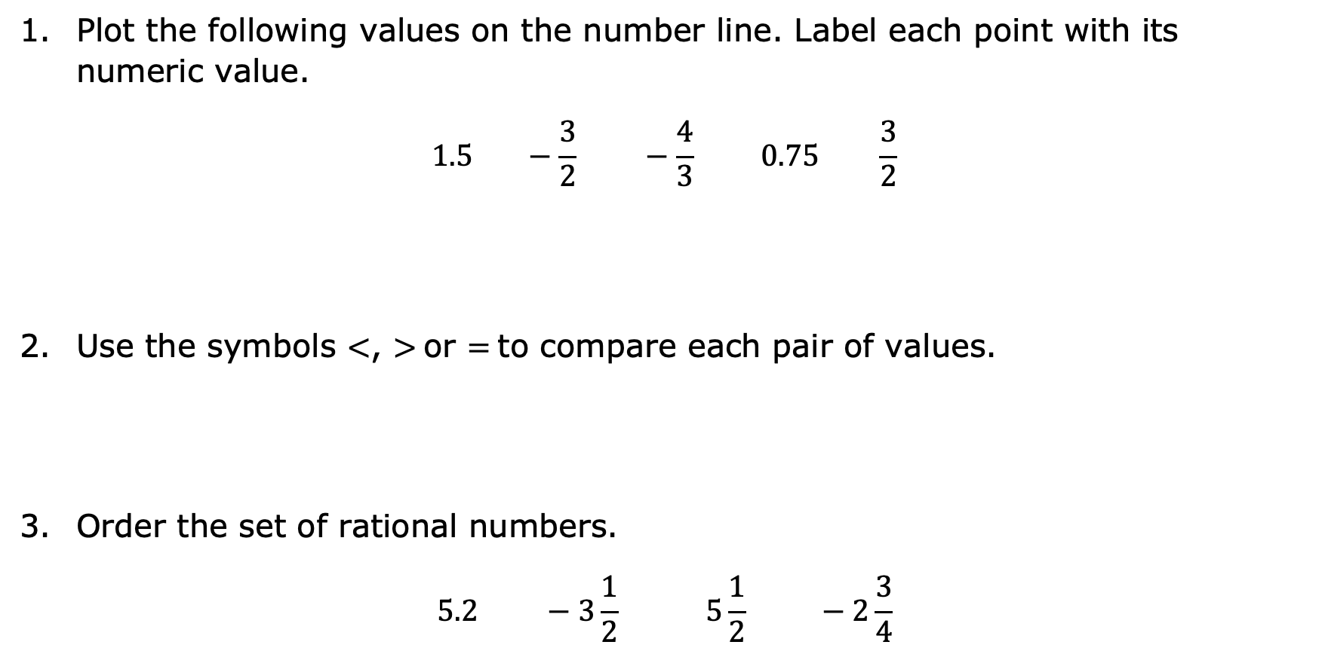
4.4.4 Your Turn!
Plot the following values on the number line. Label each point with its numeric value.
$$1.5 −\frac{3}{2} −\frac{4}{3} 0.75 \frac{3}{2}$$
Use the symbols $<$, $>$or $=$to compare each pair of values.
Order the set of rational numbers.
$$5.2 −3\frac{1}{2} 5\frac{1}{2} −2\frac{3}{4}$$
$−\frac{4}{3}$ ___ $−\frac{3}{2}$ | $0.75$ ___ $\frac{3}{2}$ | $\frac{3}{2}$ ___ $1.5$
volume 1, pg. 155

Slide 14

Wrap-Up
volume 1, pg. 155

Slide 15
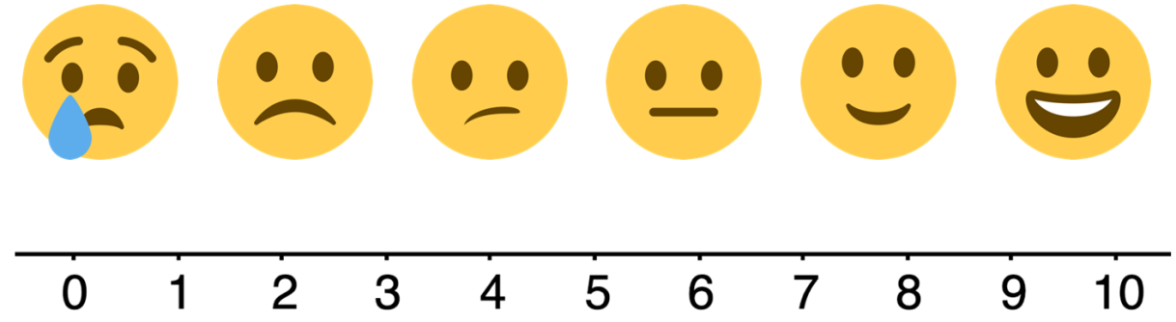
4.4.5 Wrap-Up: Reflection
Circle the emoji that best represents your understanding of the lesson today.
Write an explanation of why you chose that emoji.
volume 1, pg. 155

